Slide 1



Entertainer
Data Analysis
Prepared by : Suraj Chandangiriwar

Slide 2




Objective:
Normal life can be stressful,and people need to relax. Being entertained by others is a wonderful way to
take some time out of life. It can reduce stress and make life's issues easier to face. The media and entertainment industry consists of film, television, radio and print. These segments include movies, TV shows, radio shows, news, music, newspapers, magazines, and books. Entertainment industry is a group of sub-industries devoted to entertainment. Entertainment industry is used to describe the mass media companies that control the distribution and manufacture of mass media entertainment
2

Slide 3



Benefits:
User can easily analyse about their
favourite entertainer through the dashboards in terms of how many awards he/she won
Contoso
S u i t e s
3

Slide 4


Tasks:
write the process and data added to the current dataset.
In addition, mention the theme on which you will be creating the dashboard.
You can add your data as per your convenience.
Do the data preparation part.
Build the dashboards Build a Storyline
Contoso
S u i t e s
4

Slide 5


Data Preparation and Description:
Data Was Given in three part: Entertainer – Basic Info, Entertainer – Breakthrough Info and Entertainer – Last work Info.
Given data is not that much sufficient for analysis part,so additional information is required to add.
I added number of awards and nominees won by them,awards from breakthrough etc.
Data is in form of numeric and alphabets.
Additional data is added from IMDb's official website and I made a excel file of it.
Then I merge them in Power Query of Power BI and give name Entertainer data
Contoso
S u i t e s
5

Slide 6


Column Name | Description
Entertainer | Name of Entertainer
Profession | Category of Enteratiner
Gender | Gender of entertainer
Birth Year | Birth year of entertainer
Year of Breakthrough | Year of breakthrough of entertainer. Breakthrough means super hit or career changing performance by entertainer
Breakthrough Name | Name of breakthrough. It can be any musical album, TV shows, movie etc.
Year of First Awards | Year of first mega award won by entertainer.
Year of Last Major Work | Last appearance of that entertainer
Year of Death | Death year of that entertainer (if they die).
Total Awards won | Total number of awards won by entertainer
Total Nominees | Total number of nominees by entertainer for whichever award they were candidate
Oscar won | Number of total Oscars won by entertainer.
Grammy won | Number of total Grammies won by entertainer.
Emmy won | Number of total Emmieswon by entertainer.
No. of other awards won | Number of total other awards won by entertainer.
Award won from Breakthrough: | Any award/s from breakthrough. I only wrote mega awards they won in this column. If they had other awards for breakthrough, I wrote “other”, if they haven’t, I wrote “No Award”. If they have mega award, I wrote that award name.
Column Name Description
Entertainer Name of Entertainer
Profession Category of Enteratiner
Gender Gender of entertainer
Birth Year Birth year of entertainer
Year of Breakthrough Year of breakthrough of entertainer. Breakthrough means super hit or career changing performance by entertainer
Breakthrough Name Name of breakthrough. It can be any musical album, TV shows, movie etc.
Year of First Awards Year of first mega award won by entertainer.
Year of Last Major Work Last appearance of that entertainer
Year of Death Death year of that entertainer (if they die).
Total Awards won Total number of awards won by entertainer
Total Nominees Total number of nominees by entertainer for whichever award they were candidate
Oscar won Number of total Oscars won by entertainer.
Grammy won Number of total Grammy won by entertainer.
Emmy won Number of total Emmy won by entertainer.
No. of other awards won Number of total other awards won by entertainer.
Award won from Breakthrough: Any award/s from breakthrough. I only wrote mega awards they won in this column. If they had other awards for breakthrough, I wrote “other”, if they haven’t, I wrote “No Award”. If they have mega award, I wrote that award name.

Slide 7



Tools Used:

Slide 8
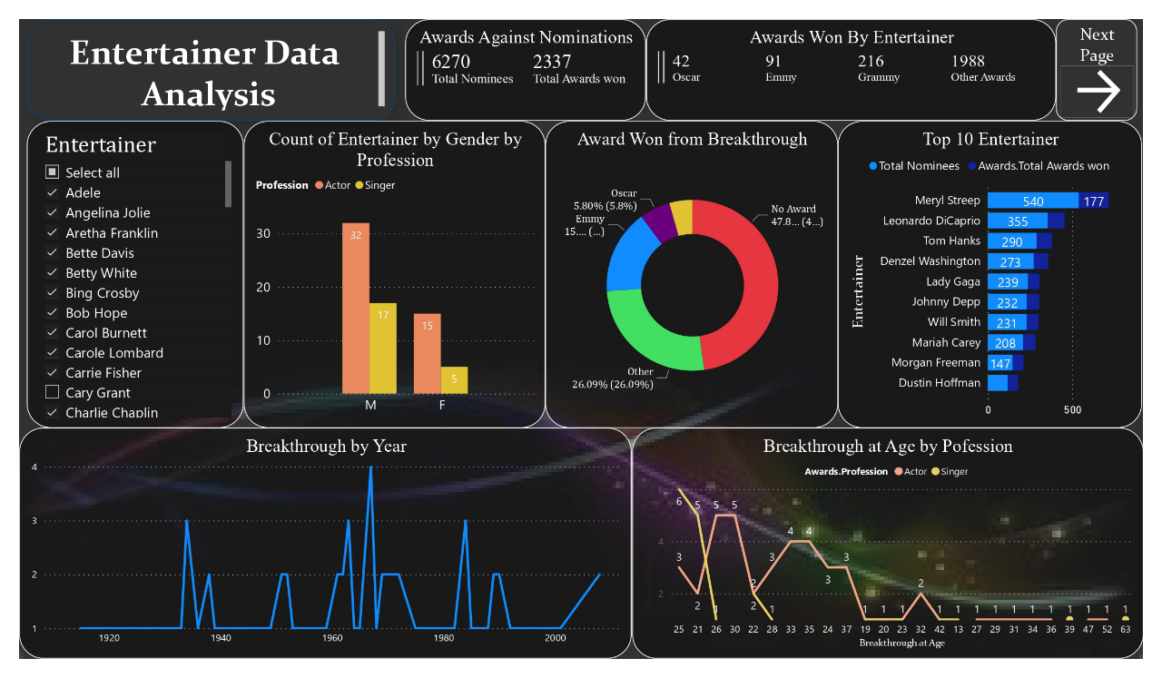
Dashboard 1

Slide 9
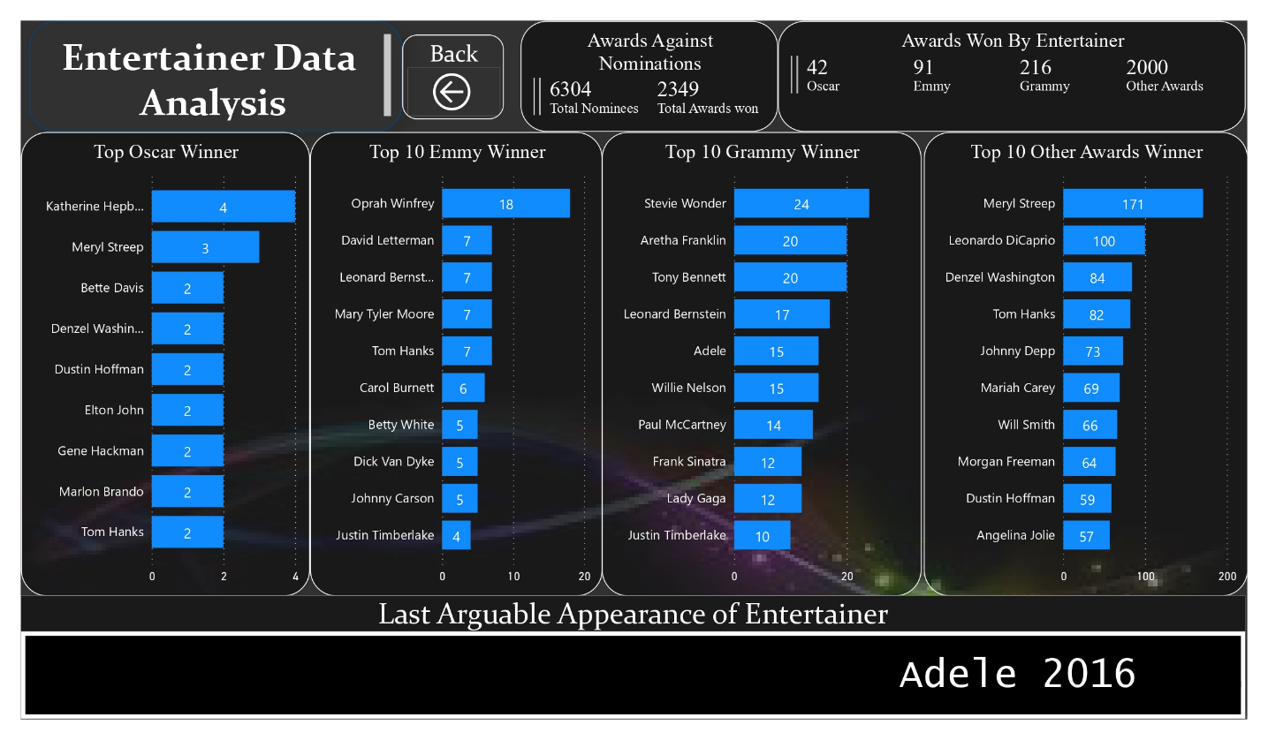
Dashboard 2

Slide 10

Analysis:
Mery Streep is the best entertainer with 177 total wins including 3 Oscars and 3 Emmies also she has 540 nominees .
Approx. 48% Entertainer did not get in their break through
Most of the entertainers are from actors' category
Katherine Hepburn has highest Oscars (4).
Orpah Winfrey has highest Emmies (18).
Stevie Wonder has highest Grammies (24)
In 1962, the entertainer got the most awards
Contoso
S u i t e s
10

